Slide 1
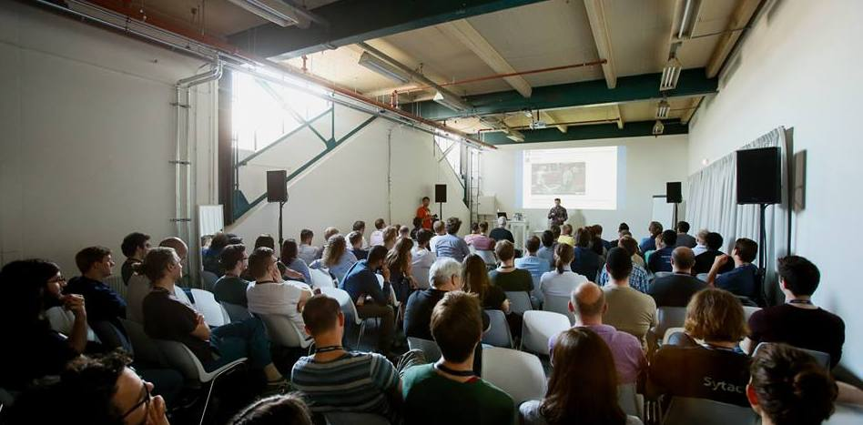
Stack Overflow Behind the Scenes
CODEMOTION MILAN - SPECIAL EDITION 10 – 11 NOVEMBER 2017
Oded Coster - @OdedCoster

Slide 2
Who Am I?
Nearly 5 years at Stack Overflow

Slide 3
Overview
The numbers
Teamwork
Web platform
Scaling/Performance
The Cloud

Slide 4
The Numbers
For Stack Overflow and all other Q&A sites and the different services (chat, stackexchange.com, Talent, Business etc…)

Slide 5
1.3 Billion
Page Views per Month

Slide 6
370 Million
HTTP requests a day
(CDN gets another 3.7 billion)
that’s 99.9% cached!

Slide 7
528 Million
Stack Overflow database Queries a Day
(11,000 queries/second at peak)

Slide 8
3.75 Billion
Redis operations a Day
(60,000 operations a second)

Slide 9
3,644
Tag Engine Requests per Minute

Slide 10
34 Million
Elasticsearch Searches per Day

Slide 11
600,000
Sustained web socket connections
(15,000 connections/second at peak)

Slide 12
5.5 Billion
HAProxy Requests per Months
(4,500 requests/second at peak)

Slide 13
55 Terabytes
Transferred a Month

Slide 14
The Numbers
Hardware

Slide 15
2 Microsoft SQL Servers
(1 is a read-only replica)
1.5TB Ram, 16 cores * 2
(Stack Overflow)

Slide 16
2 Microsoft SQL Servers
(1 is a read-only replica)
768GB Ram, 8 cores * 2
(rest of network)

Slide 17
9 IIS Web Servers
(+2 for staging)
64 GB Ram, 12 cores * 2

Slide 18
2 Redis Servers
256 GB Ram, 10 cores * 2

Slide 19
3 Tag Engine Servers
(really service boxes)
64 GB Ram, 6 cores * 2 (2)
32 GB Ram, 6 cores * 2 (1)

Slide 20
3 Elasticsearch Servers
192 GB Ram, 8 cores * 2

Slide 21
4 HAProxy Load Balancers
192 GB Ram, 4 cores * 2 (2)
64GB Ram, 4 cores * 2 (2)

Slide 22
2 Networks
(switches + fabric extenders)
Cisco Nexus 5596UP (sw) Cisco Nexus 2232TM (fex)

Slide 23
2 Firewalls
Fortinet 800C

Slide 24
4 Routers
Cisco ASR-1001 Cisco ASR-1001-x

Slide 25
The Numbers
Server side render times

Slide 26
18.3 ms
(on average)
To Render a Question Page

Slide 27
12.2 ms
(on average)
To Render the Home Page

Slide 28
How it is done
Teamwork

Slide 29
Globally Distributed
Stack Overflow has people all over the world:
SE Asia: Japan, Australia
Across Europe (Russia, France, Slovenia, Germany, UK and more)
Across the US (New York, Colorado, Hawaii, North Carolina and more)
Around 250 people

Slide 30
Project Teams
Multi-discipline teams – developers, designers, product manager, marketing, sales.
Small teams – 5-10 people in each
Focused on specific areas – Talent, Q&A Profiles, DAG, Jobs etc…

Slide 31
Online Communication
Sync:
Stack Chat / Slack (team preference)
Google Hangouts
Zoom (for larger groups/presentations)
Video is recorded and uploaded to YouTube channel.

Slide 32
Online Communication
Async:
Google Docs - specs, RFCs…
Trello – project work, organising
YouTube - keynotes, fireside chat
Point: have a record that people can refer to wherever and whenever they are

Slide 33
Chat Bots
Say when CI builds happen and what’s in them:
Who built to production and when:

Slide 34
Chat Bots
Some specific exceptions:
Unusual exception volumes:

Slide 35
Chat Bots
And a bit of fun…

Slide 36
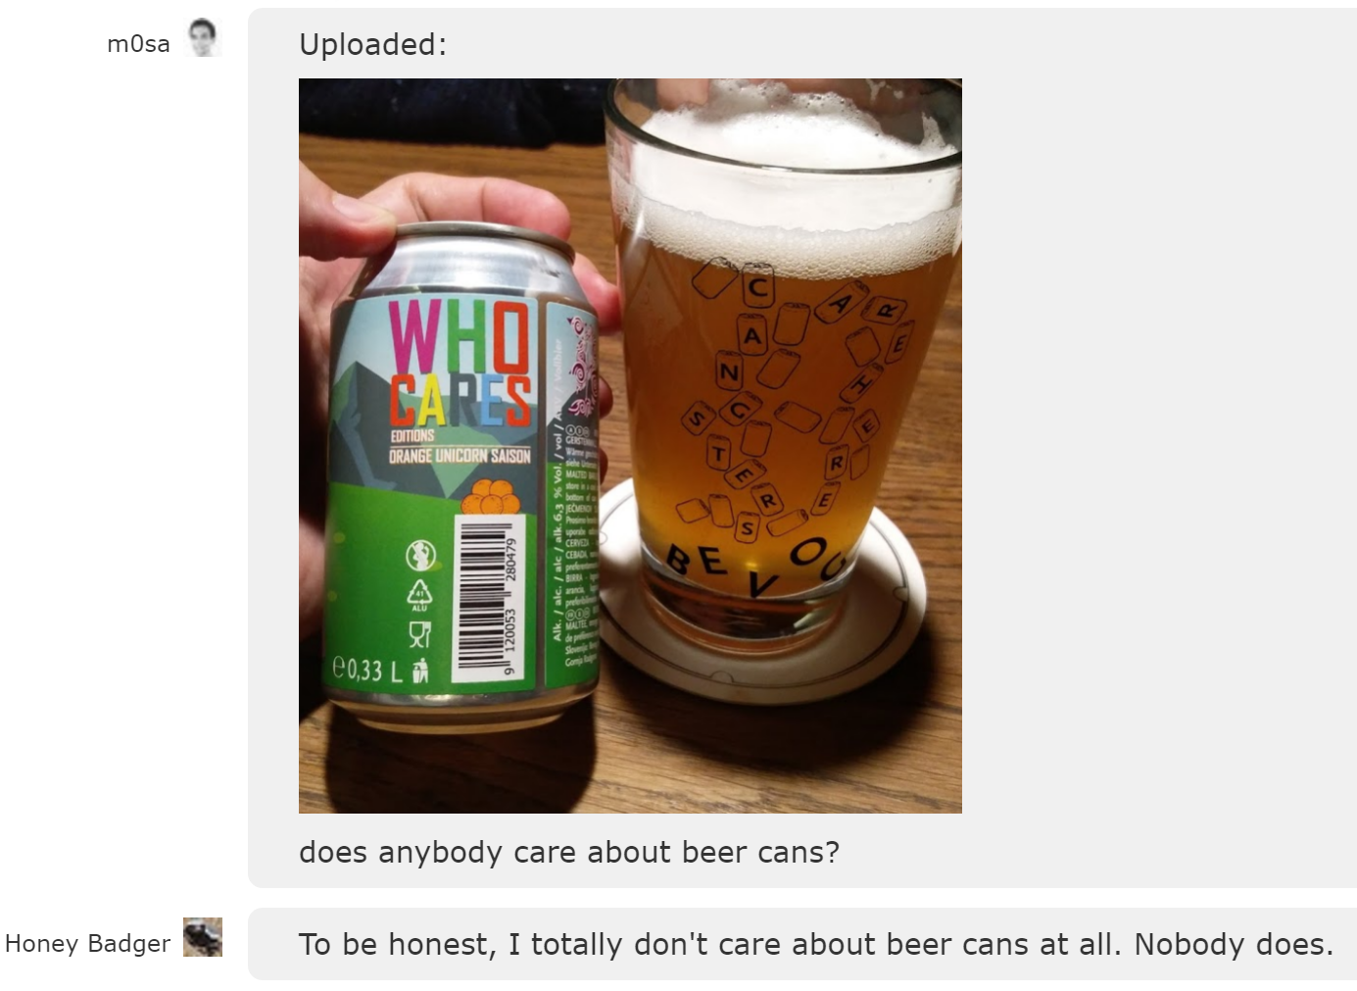
Chat Bots
And a bit of fun…

Slide 37
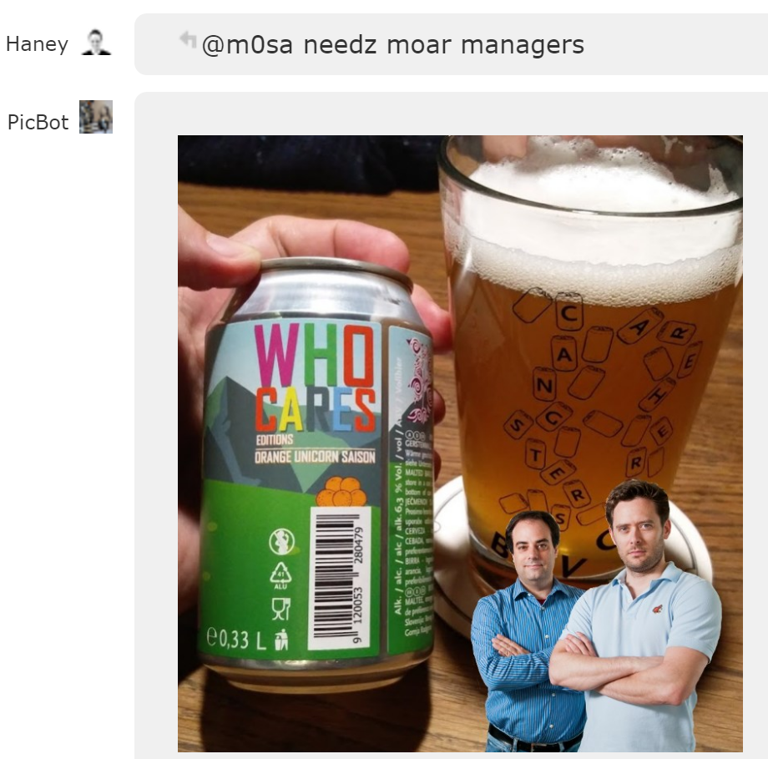
Chat Bots
And a bit of fun…

Slide 38
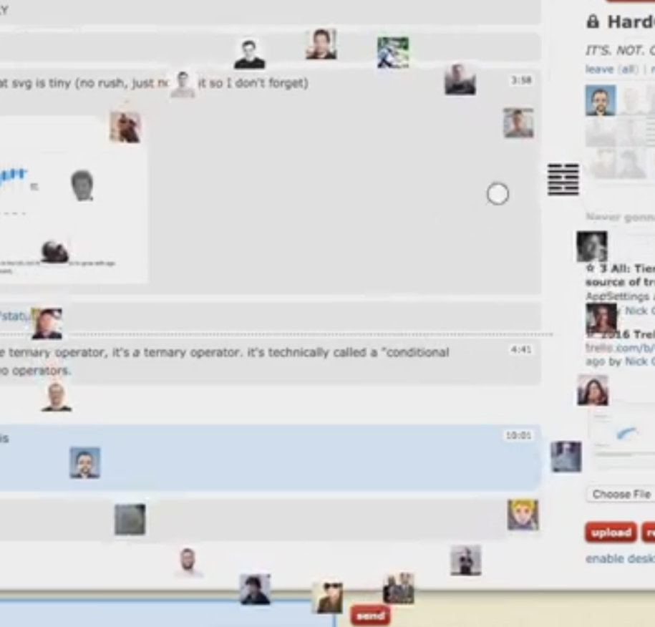
Chat Bots
And a bit of fun…

Slide 39
How it is done
Web framework

Slide 40
Core Stack
C#
LESS ➔ CSS
TypeScript ➔ JavaScript
ASP.NET/MVC
IIS
SQL Server – T-SQL

Slide 41
Supporting Cast
HAProxy - on CentOS
Redis - on CentOS
Elasticsearch - on CentOS
Tag Engine - on Windows

Slide 42
Technology Agnostic
Stack Overflow uses what makes sense and in a way it makes sense to use.
HAProxy on windows? Doesn’t make sense
Tag Engine on Linux? Doesn’t make sense (yet!)

Slide 43
Tools
Visual Studio
Git
GitLab
TeamCity
SSMS

Slide 44
Development Process
Local environments for developers
IIS, SQL Server, Redis, Elasticsearch, socket server
devlocalsetup – powershell scripts to install pretty much the whole stack, as needed
Mostly work off master
For complex work and reviews – PRs
Not much in tests
Depends on team

Slide 45
Promotion to Production
Can by done by any developer at any time – one click deploy
CI build to dev on push to origin
Meta build – “staging”
Prod build
Watch logs and metas

Slide 46
What the Build does
Localization (JavaScript, C#, Razor views)
LESS compilation + minification
JavaScript bundling + minification
TypeScript transpiles are during dev
Configuration transforms
SQL migrations – in house tool
Rolling build – 100% uptime

Slide 47
How it is done
Performance

Slide 48
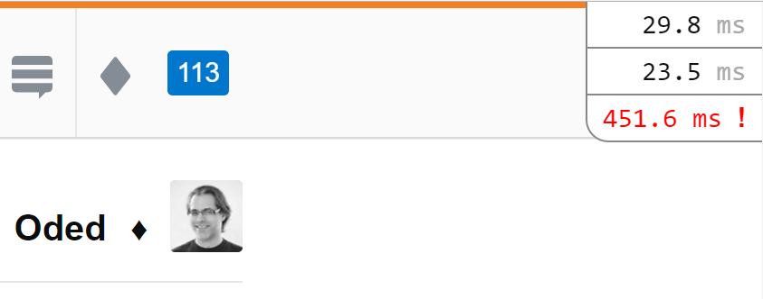
Monitoring and Alerting
Mini Profiler

Slide 49
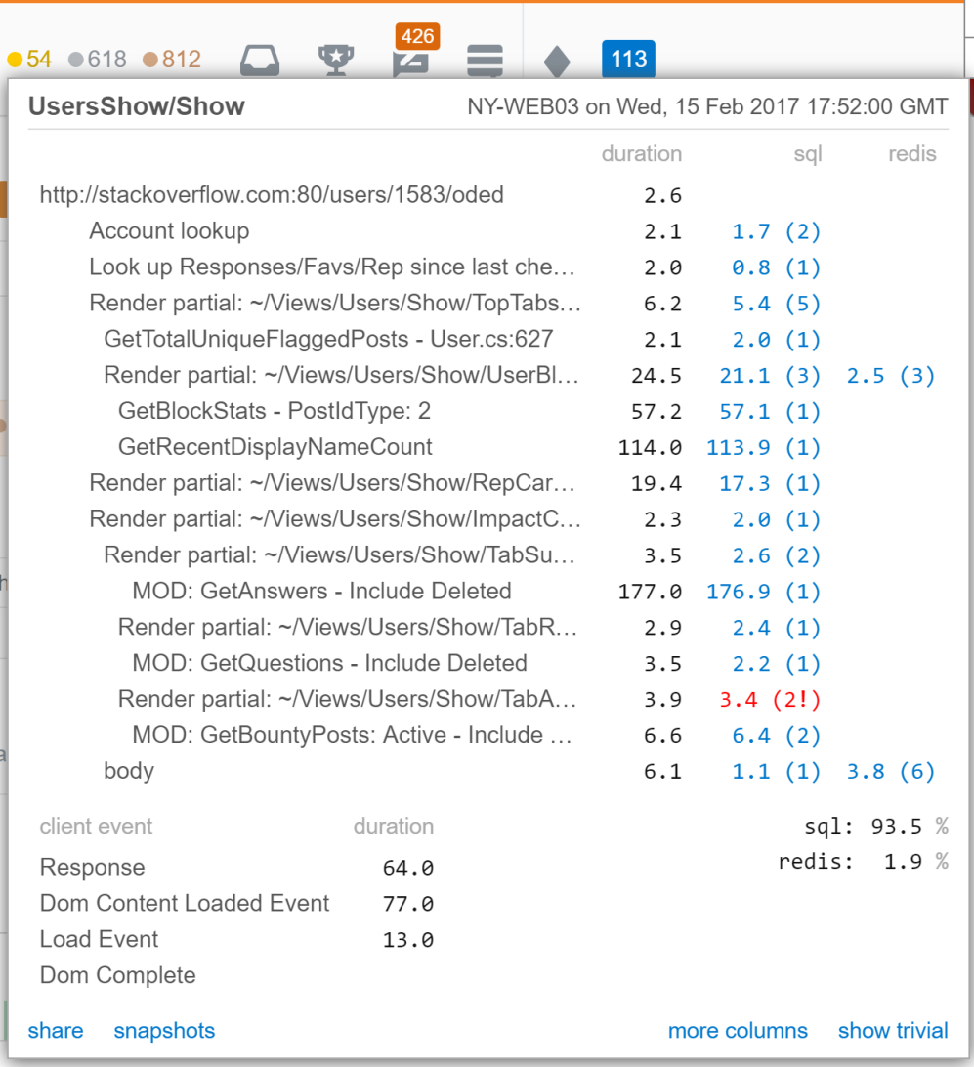
Monitoring and Alerting

Slide 50
Monitoring and Alerting

Slide 51
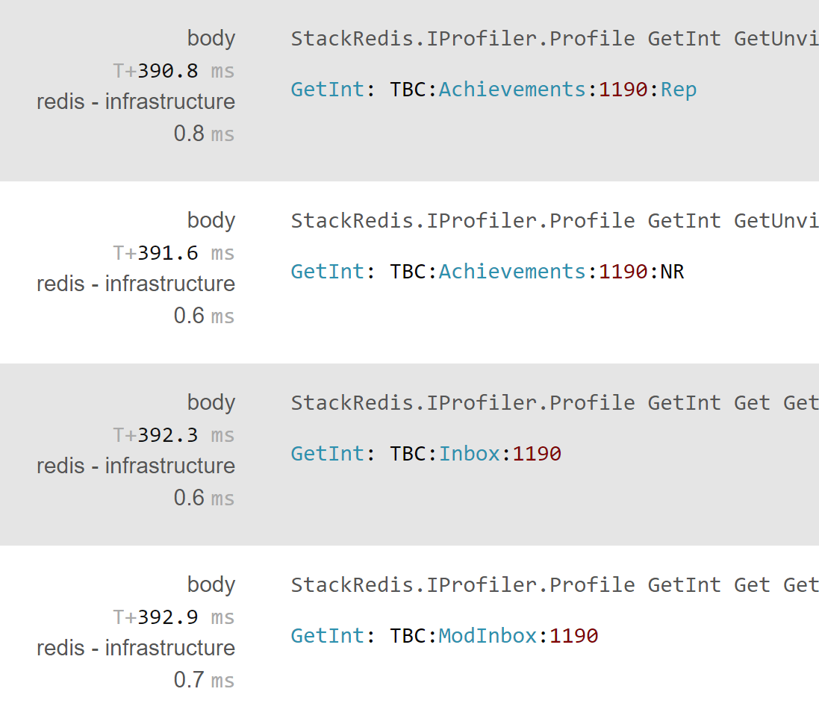
Monitoring and Alerting

Slide 52
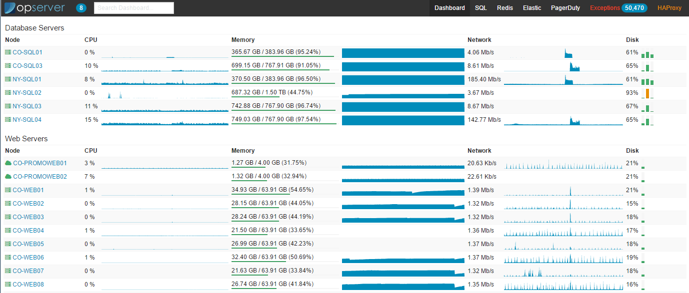
Monitoring and Alerting
Opeserver – dashboard and more

Slide 53
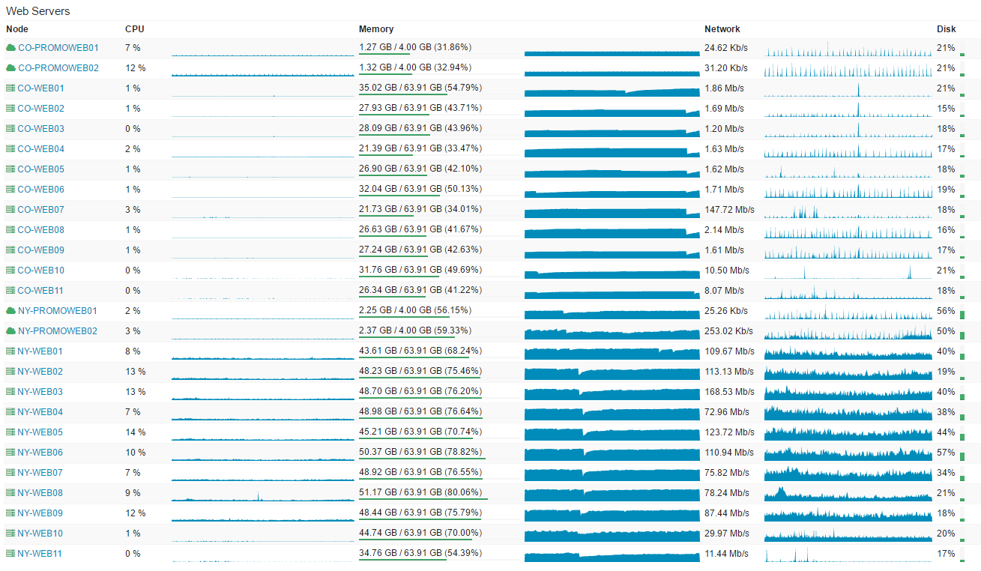
Monitoring and Alerting
Web servers

Slide 54
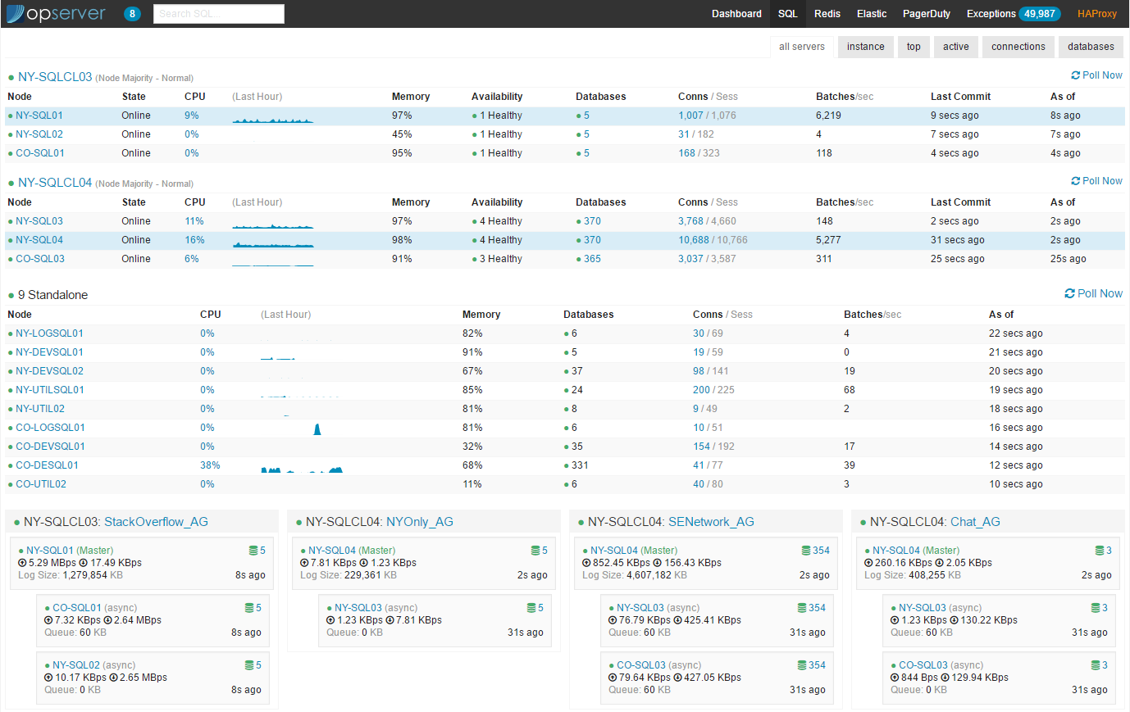
Monitoring and Alerting
SQL servers

Slide 55
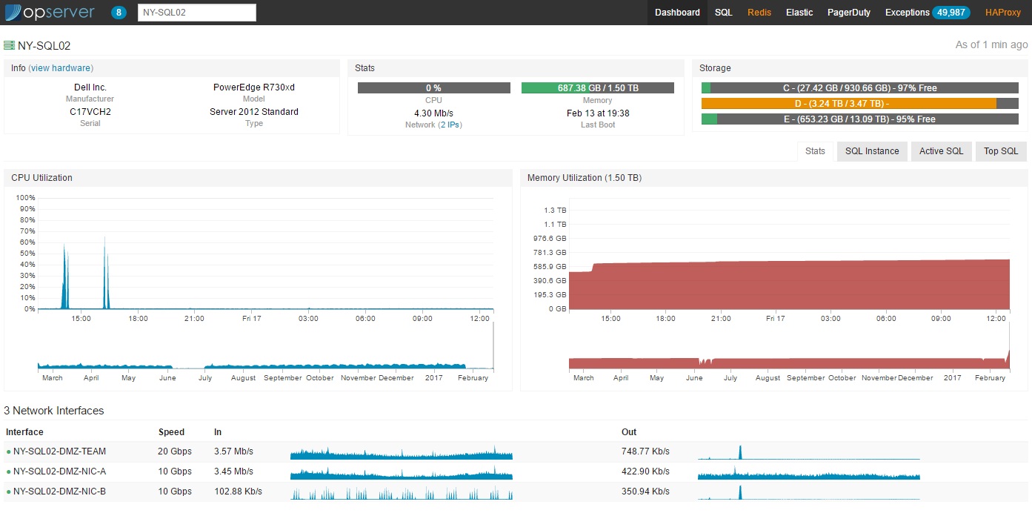
Monitoring and Alerting
SQL server – drill in

Slide 56
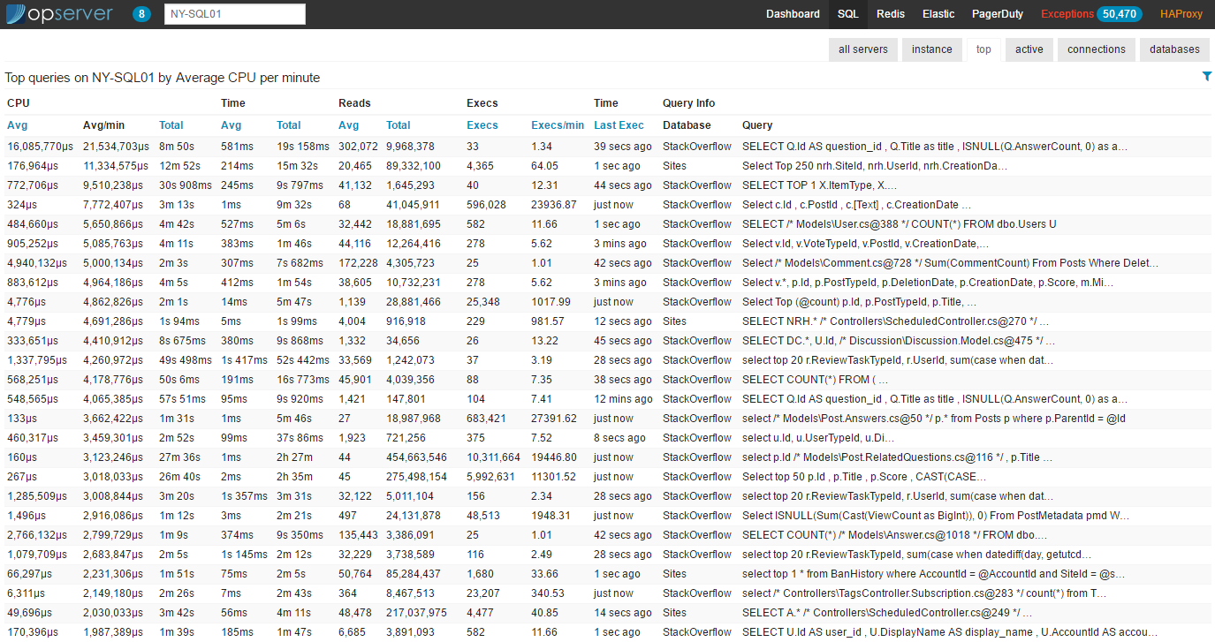
Monitoring and Alerting
SQL server – top queries

Slide 57
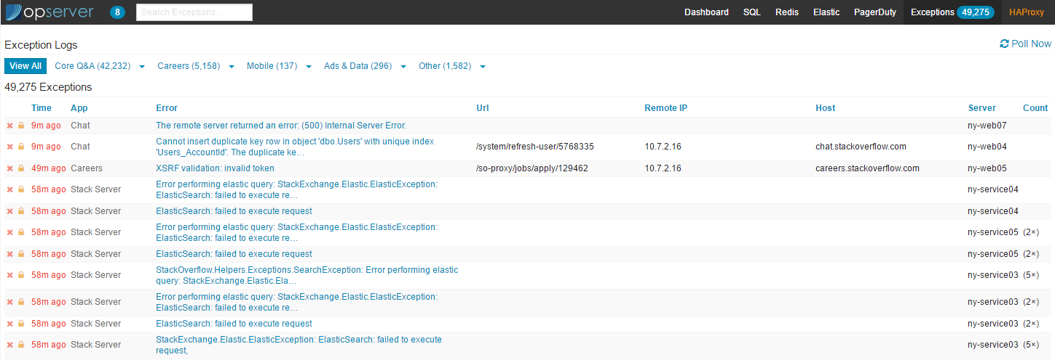
Monitoring and Alerting
Exceptions

Slide 58
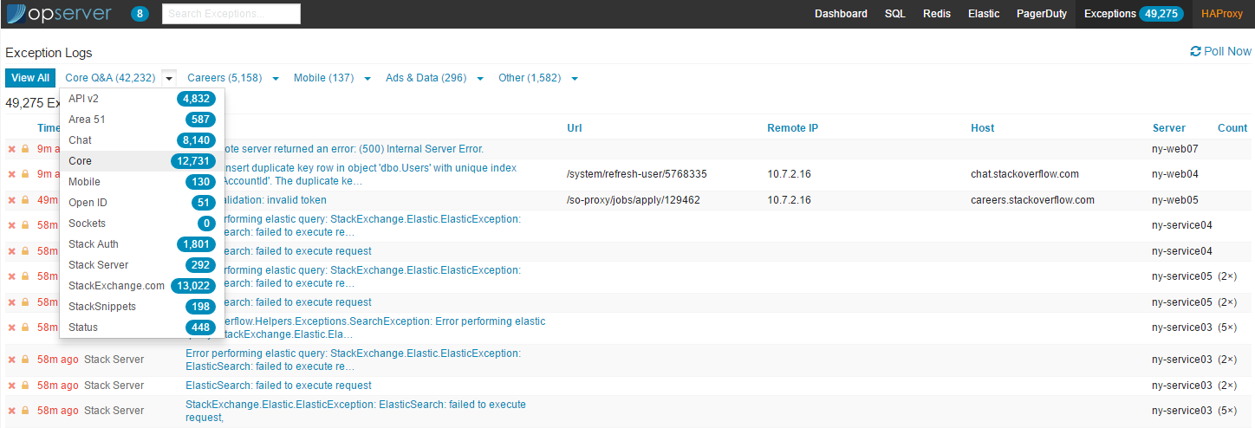
Monitoring and Alerting
Exceptions

Slide 59
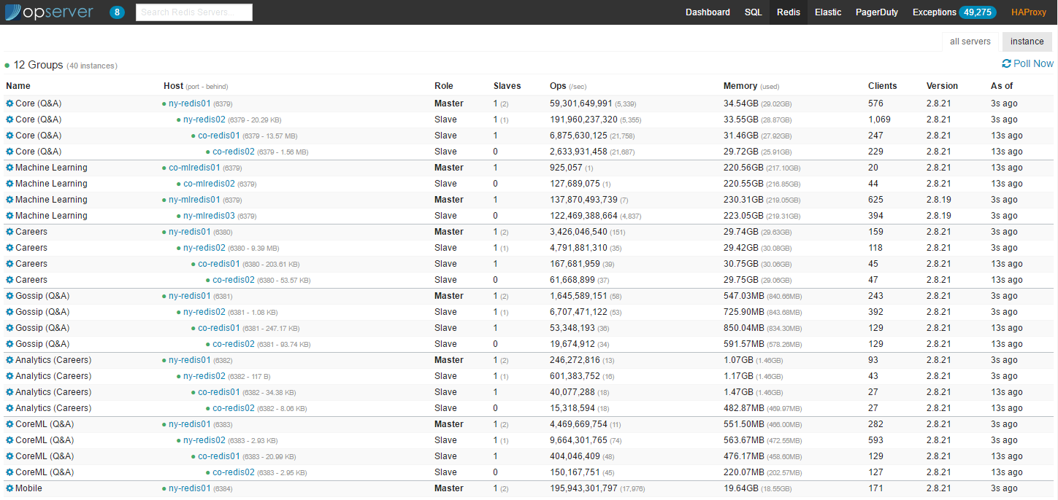
Monitoring and Alerting
Redis

Slide 60
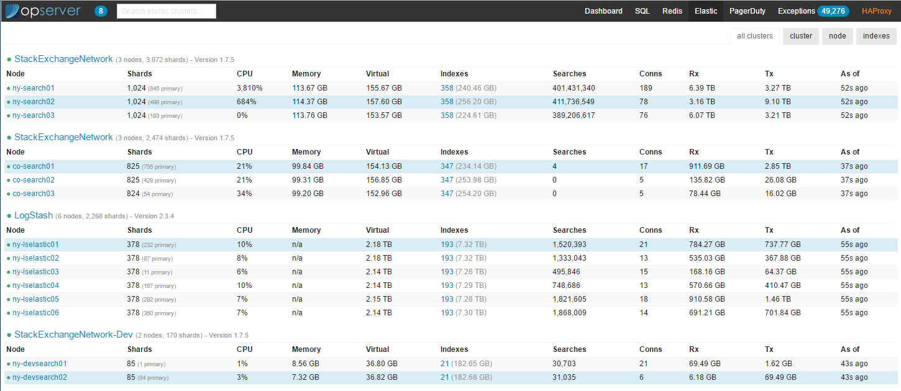
Monitoring and Alerting
Elasticsearch

Slide 61
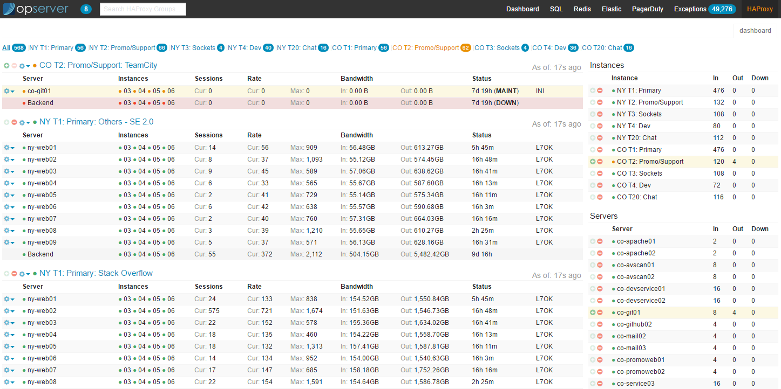
Monitoring and Alerting
HAProxy

Slide 62
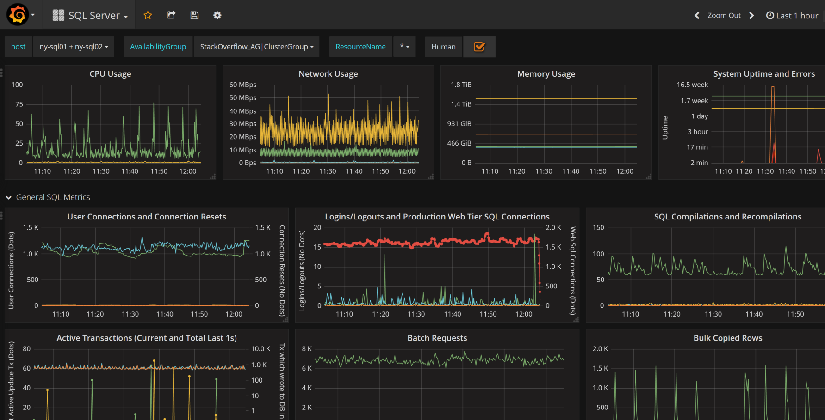
Monitoring and Alerting
Grafana – dashboards

Slide 63
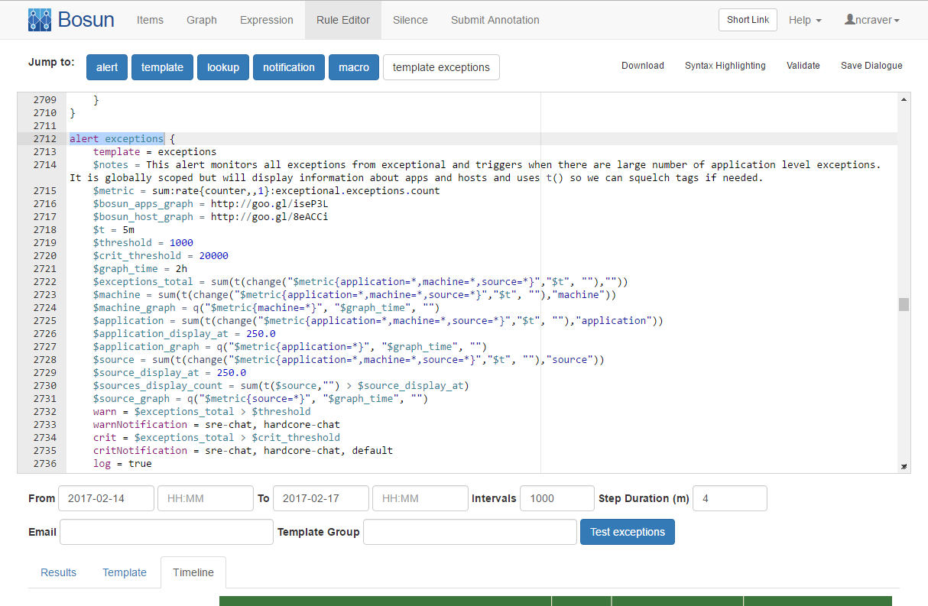
Monitoring and Alerting
Bosun

Slide 64
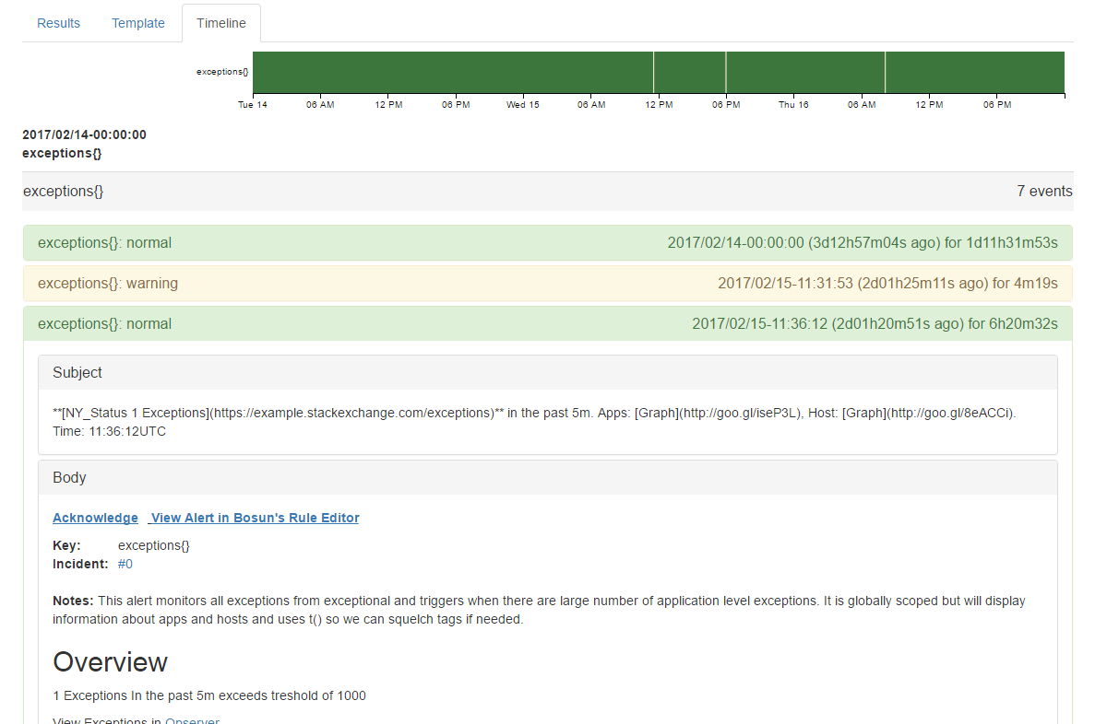
Monitoring and Alerting
Bosun

Slide 65
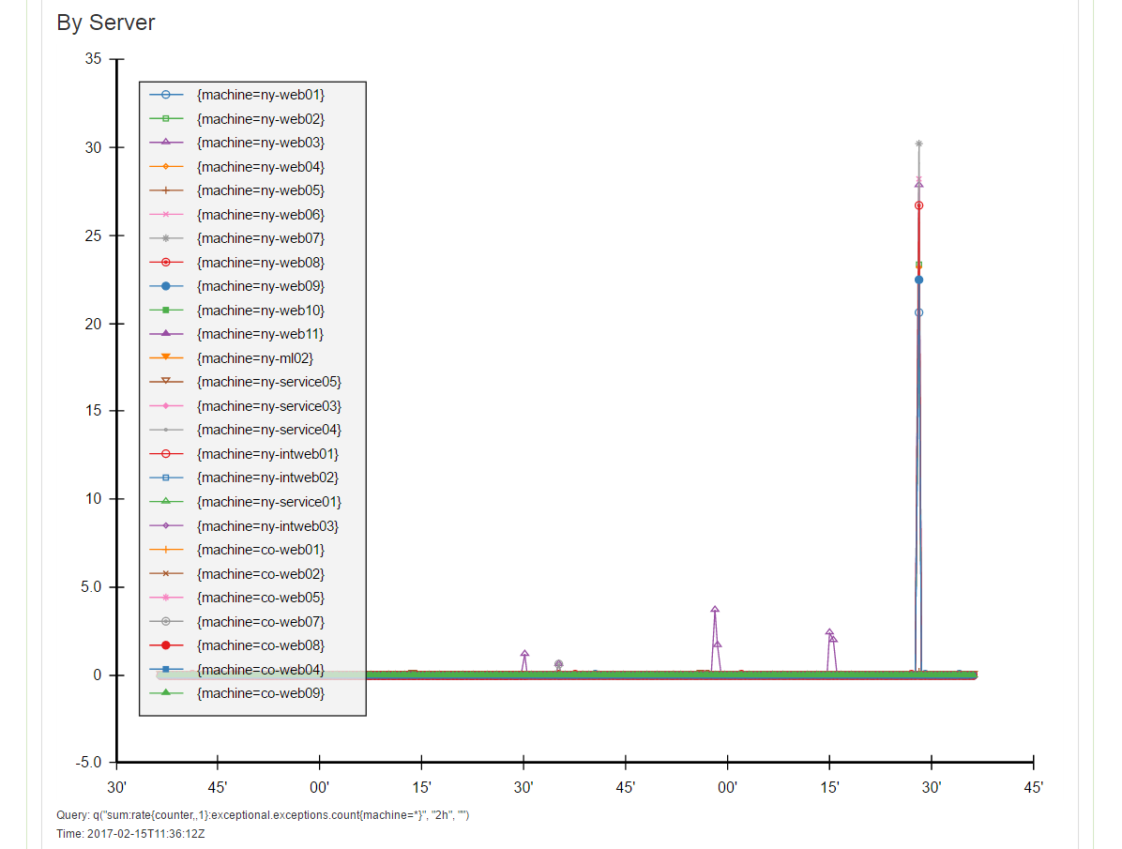
Monitoring and Alerting
Bosun

Slide 66
Monitoring and Alerting
Mini profiler: github.com/MiniProfiler
Opserver: github.com/opserver/Opserver
Grafana: grafana.org
Bosun: bosun.org
Stack Overflow OSS: stackexchange.github.io

Slide 67
Stack Overflow can run off one web server – that’s how much headroom they have.
This is a fact – it has happened, though not intentionally!
(bad deploy left only one web server operating)

Slide 68
Optimization - Monitoring
All the monitoring mentioned previously is essential to their great performance.
You can’t optimize what you can’t measure.

Slide 69
Optimization - SQL
Writing highly optimized SQL – everyone on the team goes through a SQL course where we learn how to read query plans and optimize written SQL.
Mini Profilers helps us find badly performing queries.

Slide 70
Caching
Multiple levels of caching:
L1 cache – on each web server
L2 cache – Redis
Caches include results from the DB, HTML fragments and so on

Slide 71
Fast libraries
When existing functionality is not fast enough and no 3rd party library is fast enough – we will sometimes write our own highly optimized / specific library.
Dapper – a micro ORM
Jil – a JSON serializer / deserializer

Slide 72
Did I mention caching?

Slide 73
Performance – misc
Performance is important to them – performance is a feature
Everyone on the team understands the low level of performance
Understanding when to offload work – for example tag engine

Slide 74
How it is done
“The Cloud”

Slide 75
Cloud Philosophy
More expensive than co-located servers
Unfit for their requirements:
Extreme high performance
Tight control of above
Likely require re-engineering the DB (Stack Overflow DB larger than largest Azure offering)

Slide 76
Cloud Philosophy - continued
Doesn’t afford as much capacity headroom
Unreliable internal network (slow, jittery)
Latency issues
Used for:
Backups (glacier)
DNS

Slide 77
Thank you!
Questions?
Oded Coster - @OdedCoster

